Slide 2
OUTLINE
Data Types
Complements
Fixed-Point Representation
Conversion of Fractions
Floating-Point Representation
Other Binary Codes

Slide 3
OUTLINE
Register transfer Language
Register Transfer
Bus and Memory Transfers
Arithmetic Micro Operations
Logic Micro operations
Shift Micro Operations
Arithmetic Logic Shift unit

Slide 4
DATA TYPES
Binary information is stored in memory or processor registers.
Registers contain either data or control information .
Data are numbers and other binary –coded information.
Control information is a bit or group of bits used to specify the sequence of command signals needed for data manipulation
• Data types found in the registers of digital computers.
Numbers used in computations.
Letters of the alphabet used in data processing.
Other discrete symbols used for specific purposes.

Slide 5
DATA TYPES
NUMBER SYSTEMS
A number system of base or radix.
r is a system that uses distinct symbols for r digits
Numbers are represented by a string of digit symbols
Most common number system: Decimal, Binary, Octal ,Hexadecimal
DECIMAL SYSTEM/BASE-10 SYSTEM
Composed of 10 symbols or numerals (0, 1, 2, 3, 4, 5, 6, 7, 8, 9)
BINARY SYSTEM/BASE-2 SYSTEM
It has two symbols : 0 and 1
A binary digit is called a bit.

Slide 6
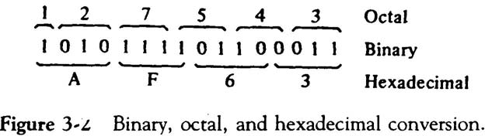
DATA TYPES
HEXADECIMAL SYSTEM/BASE-16 NUMBER SYSTEM
Composed of 16 symbols or numerals (0, 1, 2, 3, 4, 5, 6, 7, 8, 9, A, B, C, D, E, F)
called hexdigits.
Each octal digit corresponds to three binary digits.
Each hexadecimal digit corresponds to four binary digits.
Binary ,Octal and Hexadecimal conversion

Slide 7
DATA TYPES
BINARY-TO-DECIMAL CONVERSIONS
1011.101₂ = (1 x 2³) + (0 x 2²)+ (1 x 2¹) + (1 x 2º) + (1 x 2⁻¹) + (0 x 2⁻²) + (1 x 2⁻³)
= 8₁₀+ 0 + 2₁₀ + 1₁₀ + 0.5₁₀ + 0 + 0.125₁₀
= 11.625₁₀
DECIMAL-TO-BINARY CONVERSIONS
Repeated division
37 / 2 = 18 remainder 1 (binary number will end with 1) : LSB
18 / 2 = 9 remainder 0
9 / 2 = 4 remainder 1

Slide 8
DATA TYPES
4 / 2 =2 remainder 0
2 / 2 = 1 remainder 0
1 / 2 = 0 remainder 1 (binary number will start with 1) : MSB
Read the result upward to give an answer of 37₁₀ = 100101₂
Hex-to-Decimal Conversion
2AF16 = (2 x 16²) + (10 x 16¹) + (15 x 16º)
= 51210 + 16010 + 1510
= 68710

Slide 9
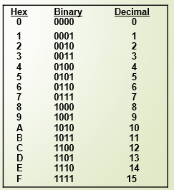
DATA TYPES
HEX-TO-BINARY CONVERSION
9F2₁₆ = 9 F 2
= 1001 1111 0010
= 100111110010₂
BINARY-TO-HEX CONVERSION
1 1 1 0 1 0 0 1 1 0₂ = 0 0 1 1 1 0 1 0 0 1 1 0
= 3 A6
16

Slide 10
DATA TYPES
BINARY-CODED-DECIMAL CODE
Each digit of a decimal number is represented by its binary equivalent
8 7 4 (Decimal)
1000 0111 0100 (BCD)
Only the four bit binary numbers from 0000 through 1001 are used
COMPARISON OF BCD AND BINARY
137₁₀ = 10001001₂ (Binary) - require only 8 bits
137₁₀ = 0001 0011 0111_{BCD} (BCD) - require 12 bits

Slide 11
Complements
(r - l)'s Complement
(r's) Complement

Slide 12
REGISTER TRANSFER LANGUAGE
DEFINITION:
The symbolic notation used to describe the microoperation transfers among registers is called a register transfer language.
The term "register transfer" implies the availability of hardware logic circuits that can perform a stated microoperation and transfer the result of the operation to the same or another register.
The word "language" is borrowed from programmers, who apply this term to programming languages.
A register transfer language is a system for expressing in symbolic form the microoperation sequences among the registers of a digital module.

Slide 13
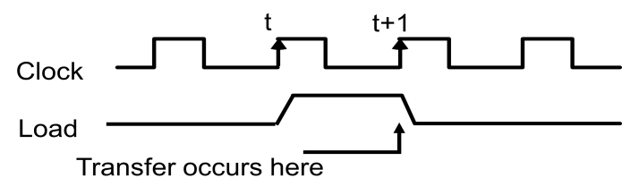
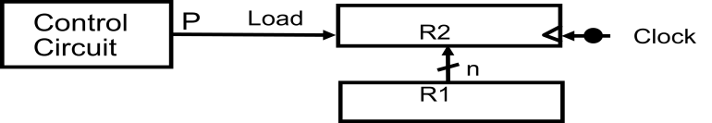
REGISTER TRANSFERS
DEFINITION
Information transfer from one register to another is designated in symbolic form by means of a replacement operator is known as Register Transfer.
R2 ← R1
Denotes a transfer of the content of register R1 into register R2.
Every statement written in a register transfer notation implies a hardware construction for implementing the transfer.
FIG 2.1:TRANSFERS FROM R1 TO R2 WHEN P=1
FIG 2.2: TIMING DIAGRAM

Slide 14
REGISTER TRANSFERS
TABLE 2.1: BASIC SYMBOLS USED FOR REGISTER TRANSFERS
Basic Symbols for Register Transfers
Symbol | Description | Examples
Letters & numerals | Denotes a register | MAR, R2
Parenthesis ( ) | Denotes a part of a register | R2(0-7), R2(L)
Arrow ← | Denotes transfer of information | R2 ← R1
Comma , | Separates two microoperations | R2 ← R1, R1 ← R2

Slide 15
BUS AND MEMORY TRANSFERS
Paths must be provided to transfer information from one register to another
A Common Bus System is a scheme for transferring information between registers in a multiple-register configuration
A bus: set of common lines, one for each bit of a register, through which binary information is transferred one at a time
Control signals determine which register is selected by the bus during each particular register transfer.

Slide 16
BUS AND MEMORY TRANSFERS
Register A
Register B
Register C
Register D
Bus lines
Register D
Register C
Register B
Register A
3 2 1 0
3 2 1 0
3 2 1 0
3 2 1 0
D₃ D₂ D₁ D₀
C₃ C₂ C₁ C₀
B₃ B₂ B₁ B₀
A₃ A₂ A₁ A₀
D₃ C₃ B₃ A₃
D₂ C₂ B₂ A₂
D₁ C₁ B₁ A₁
D₀ C₀ B₀ A₀
3 2 1 0
3 2 1 0
3 2 1 0
3 2 1 0
S₀
S₀
S₀
S₀
MUX3
S₁
MUX2
S₁
MUX1
S₁
MUX0
S₁
4-Line Common Bus

Slide 17
BUS AND MEMORY TRANSFERS
The two selection lines S 1 and S0 are connected to the selection inputs of all four multiplexers.
When S 1 S0 = 00, the 0 data inputs of all four multiplexers are selected and applied to the outputs that form the bus.
This causes the bus lines to receive the content of register A since the outputs of this register are connected to the 0 data inputs of the multiplexers.
Register B is selected if S 1S0 = 01, and so on.
S1 | S0 | SELECTED REGISTER
0 | 0 | REGISTER 0
0 | 1 | REGISTER 1
1 | 0 | REGISTER 2
1 | 1 | REGISTER 3
Table 2.2: Function Table for Bus

Slide 18
BUS AND MEMORY TRANSFERS
The transfer of information from a bus into one of many destination registers is done:
By connecting the bus lines to the inputs of all destination registers and then:
activating the load control of the particular destination register selected
We write: R2 ← C to symbolize that the content of register C is loaded into the register R2 using the common system bus
It is equivalent to: BUS ←C, (select C)
R2 ←BUS (Load R2)

Slide 19
BUS AND MEMORY TRANSFERS
THREE-STATE BUS BUFFER
A bus system can be constructed with three-state buffer gates instead of multiplexers
A three-state buffer is a digital circuit that exhibits three states
State 1: Signal equivalent to Logic1
State 2: Signal equivalent to Logic 0
State 3: High Impedance State (behaves as open circuit)
Control input C
Normal input A
Fig 2.4 : Three State Buffer
Output Y=A if C=1 High Impedance if C=0

Slide 20
BUS AND MEMORY TRANSFERS
Bus line for bit 0
S₁
0
Select
S₀
2×4 Decoder
1
A₀
2
Enable
E
3
B₀
C₀
Fig 2.5 : Bus Line with three state-buffers
D₀

Slide 21
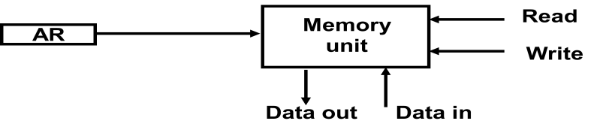
BUS AND MEMORY TRANSFERS
MEMORY TRANSFER
Read Operation: The transfer of information from a memory word to the outside environment is called a read operation.
Write Operation: The transfer of new information to be stored into the memory is called a write operation.
A memory word will be symbolized by the letter M.
Assume that the address of a memory unit is stored in a register called the Address Register AR.
Lets represent a Data Register with DR, then:
Read: DR ← M[AR]
Write: M[AR] ← DR

Slide 22
ARITHMETIC MICRO OPERATIONS
MICRO OPERATION
It is an elementary operation performed with the data stored in registers.
The micro operations are classified into four categories:
Register transfer micro operations
Arithmetic micro operations (on numeric data stored in the registers)
Logic micro operations (bit manipulations on non-numeric data)
Shift micro operations
To distinguish between arithmetic and logical operation, we may use a signal line,
0 - in that signal, represents an arithmetic operation .
1 - in that signal, represents a logical operation.

Slide 23
ARITHMETIC MICRO OPERATIONS
The basic arithmetic micro operations are:
Addition
Subtraction
Increment
Decrement
Shift
The additional arithmetic micro operations are
Add with carry
Subtract with borrow
Transfer/Load , etc.

Slide 24
ARITHMETIC MICRO OPERATIONS
OPERATION | REPRESENTATION | DESCRIPTION
ADD | R3 ¬R1 + R2 | Contents of R1 plus R2 transferred to R3
SUBTRACT | R3 ¬R1 ­ R2 | Contents of R1 minus R2 transferred to R3
1’S COMPLEMENT | R2 ¬R2’ | Complement the contents of R2
2’S COMPLIMENT | R2 ¬R2’+ 1 | 2's complement the contents of R2 (negate)
2’S COMPLIMENT SUBTRACTION | R3 ¬R1 + R2’+ 1 | ADD R1 and the 2’s compliment of R2
INCREMENT | R1 ¬R1 + 1 | Increment the contents of R1 by one
DECREMENT | R1 ¬R1 – 1 | Decrement the contents of R2 by one.

Slide 25
ARITHMETIC MICRO OPERATIONS
Half Adder/Full Adder
Half Adder
x y c s
c = xy s = xy’ + x’y
= x ⊕ y
x
y
c
s
0 0 0 0
0 1 0 1
1 0 0 1
1 1 1 0
Full Adder
y
x y c_{n-1} c_{n} s
y
0 0 0 0 0
0 0 1 0 1
0 1 0 0 1
0 1 1 1 0
1 0 0 0 1
1 0 1 1 0
1 1 0 1 0
1 1 1 1 1
0
0
0
1
0
1
c_{n-1}
1
0
c_{n-1}
x
1
1
x
0
1
0
1
1
0
c_{n}
s
c_{n} = xy + xc_{n-1}+ yc_{n-1}
= xy + (x ⊕ y)c_{n-1}
s = x’y’c_{n-1}+x’yc’_{n-1}+xy’c’_{n-1}+xyc_{n-1}
= x ⊕ y ⊕ c_{n-1} = (x ⊕ y) ⊕ c_{n-1}
x
y
S
c_{n}
c_{n-1}

Slide 26
ARITHMETIC MICRO OPERATIONS
BINARY ADDER
It generates the arithmetic sum of two binary numbers
B₃
A₃
B₂
A₂
B₁
A₁
B₀
A₀
C₃
C₂
C₁
FA
FA
FA
FA
C₀
S₃
S₂
S₁
S₀
Fig 2.6 : 4-bit binary adder

Slide 27
ARITHMETIC MICRO OPERATIONS
BINARY ADDER-SUBTRACTOR
B₃
A₃
B₂
A₂
B₁
A₁
B₀
A₀
M
C₃
C₂
C₁
C₀
FA
FA
FA
FA
C₄
S₃
S₂
S₁
S₀
FIG 2.7 : 4 BIT ADDER-SUBTRACTOR-BIT

Slide 28
ARITHMETIC MICRO OPERATIONS
BINARY ADDER-SUBTRACTOR
The mode input M controls the operation.
When M = 0 the circuit is an Adder (A+B)
When M = 1 the circuit becomes a Subtractor (A-B =A+(-B))
= A+ 1’s compliment of B+1
For unsigned numbers,
If A>=B, then A-B
If A<B, then B-A
Example: 3 – 5 = -2= 1110
For signed numbers, the result is A – B provided that there is no overflow.
Example : -3 – 5= -8
1101
1011 +
ــــــــــــــــــــــــ
1000

Slide 29
ARITHMETIC MICRO OPERATIONS
BINARY INCREMENTER
Binary Incrementer can also be implemented using a counter.
A₃
A₂
A₁
A₀
1
x
y
x
y
x
y
x
y
HA
HA
HA
HA
C
S
C
S
C
S
C
S
C₄
S₃
S₂
S₁
S₀
FIG 2.8 :4-BIT BINARY INCREMENTER
A binary decrementer can be implemented by adding 1111 to the desired register each time.

Slide 30
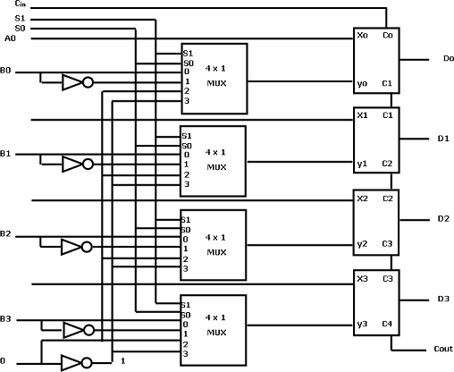
ARITHMETIC MICRO OPERATIONS
ARITHMETIC CIRCUIT
This circuit performs seven distinct arithmetic operations and the basic component of it is the parallel adder.
The output of the binary adder is calculated from the following arithmetic sum:
D = A + Y + C_{in}
FIG 2.9 :4-BIT ARITHMETIC CIRCUIT

Slide 31
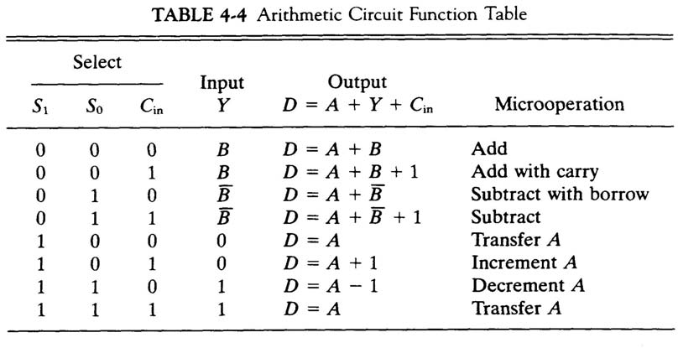
ARITHMETIC MICRO OPERATIONS
TABLE 2.3 :ARITHMETIC CIRCUIT FUNCTION TABLE

Slide 32
LOGIC MICRO OPERATIONS
LOGIC MICRO OPERATIONS
It specify binary operations for strings of bits stored in registers.
LOGIC MICRO OPERATION | SYMBOL
or | V
and | ^
complement | Bar(‾)
EX-or | Ꚛ
TABLE 2.4 : BASIC LOGIC OPERATIONS AND SYMBOLS

Slide 33
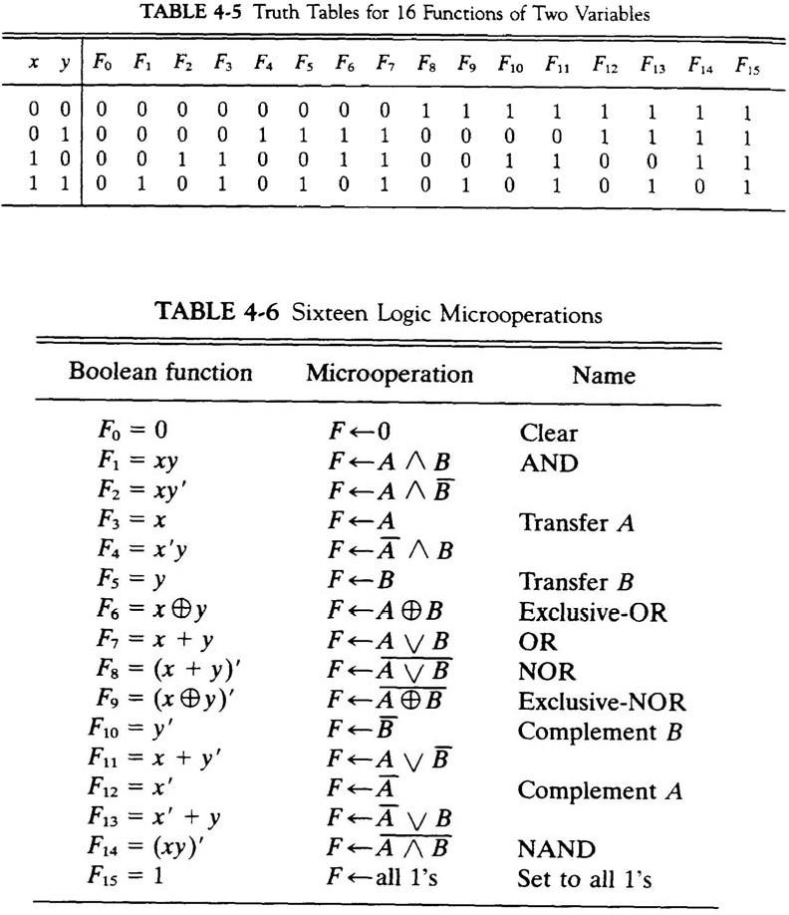
LOGIC MICRO OPERATIONS
Table2.5 :Truth Tables for 16 Functions of Two Variables

Slide 34
LOGIC MICRO OPERATIONS
TABLE 2.6 :SIXTEEN LOGIC MICROOPERATION

Slide 35
LOGIC MICRO OPERATIONS
HARDWARE IMPLEMENTION
The hardware implementation of logic micro operations requires that logic gates be inserted for each bit or pair of bits in the registers to perform the required logic function
Most computers use only four (AND, OR, XOR, and NOT) from which all others can be derived.
Hardware implementation consists of four gates and a multiplexer.
Eachofthefourlogicoperationsisgeneratedthroughagatethatperformsthe required logic.
The outputs of the gates are applied to the data inputs of the multiplexer.
The two selection inputs S 1 and S0 choose one of the data inputs of the multiplexer and direct its value to the output.

Slide 36
LOGIC MICRO OPERATIONS
(A)LOGIC DIAGRAM
(B) FUNCTION TABLE
S₁
S₁ | S₀ | Output | Operation
0 | 0 | E = A ⊕ B | XOR
0 | 1 | E = A ∨ B | OR
1 | 0 | E = A ∧ B | AND
1 | 1 | E = A | Complement
4×1 MUX
S₀
0
1
E_{i}
2
3
FIG 2.10: ONE STAGE OF LOGIC CIRCUIT

Slide 37
SHIFT MICRO OPERATIONS
Used for serial transfer of data
Also used in conjunction with arithmetic, logic, and other data-processing operations
The contents of the register can be shifted to the left or to the right
As being shifted, the first flip-flop receives its binary information from the serial input
Three types of shift:
Logical shift
Circular or Rotate shift and
Arithmetic

Slide 38
SHIFT MICRO OPERATIONS
Serial Input
r_{n-1}
r₃
r2
r₁
r₀
Serial Output
Determines the “shift” type
Shift Right
Serial Output
Serial Input
r_{n-1}
r₃
r₂
r₁
r₀
Shift Left
Note that the bit ri is the bit at position (i) of the register

Slide 39
SHIFT MICRO OPERATIONS
LOGIC SHIFT
Transfers 0 through the serial input
Logical Shift Right: R1←shr R1
Logical Shift Left: R2←shl R2
The same
The same
?
r_{n-1}
r₃
r₂
r₁
r₀
0
Logical Shift Left

Slide 40
SHIFT MICRO OPERATIONS
CIRCULAR SHIFTS (ROTATE OPERATION)
Circulates the bits of the register around the two ends without loss of information
Circular Shift Right: R1←cir R1
Circular Shift Left: R2←cir R2
The same
The same
r_{n-1}
r₃
r₂
r₁
r₀
Circular Shift Left

Slide 41
SHIFT MICRO OPERATIONS
ARITHMETIC SHIFT
Shifts a signed binary number to the left or right.
An arithmetic shift-left multiplies a signed binary number by 2.
ashl (00100): 01000
An arithmetic shift-right divides the number by 2.
ashr (00100) : 00010
An overflow may occur in arithmetic shift-left, and occurs when the sign bit is changed (sign reversal).

Slide 42
SHIFT MICRO OPERATIONS
r_{n-1}
r₃
r₂
r₁
r₀
?
Sign Bit
Arithmetic Shift Right
?
r_{n-1}
r₃
r₂
r₁
r₀
0
Sign Bit
Arithmetic Shift Left

Slide 43
SHIFT MICRO OPERATIONS
HARDWARE IMPLEMENTATION
Serial Input I_{R}
Serial Input I_{L}
A₃
A₂
A₁
A₀
Select
0 for shift right
1 for shift left
S
1
0
S
1
0
S
1
0
S
1
0
MUX
MUX
MUX
MUX
H₃
H₂
H₁
H₀
FIG 2.11 : 4-BIT COMBINATIONAL CIRCUIT SHIFTER

Slide 44
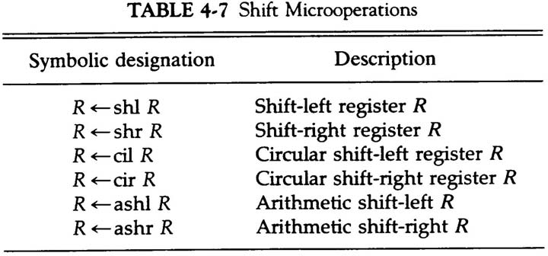
SHIFT MICRO OPERATIONS
TABLE 2.7 : ALL SHIFT MICRO OPERATIONS

Slide 45
ARITHMETIC LOGIC SHIFT UNIT
The arithmetic logic unit (ALU) is a common operational unit connected to a number of storage registers.
To perform a micro operation, the contents of specified registers are placed in the inputs of the ALU.
The ALU performs an operation and the result is then transferred to a destination register.
TheALUisacombinationalcircuitsothattheentireregistertransferoperationfrom the source registers through the ALU and into the destination register can be performed during one dock pulse period.

Slide 46
ARITHMETIC LOGIC SHIFT UNIT
S₃
S₂
S₁
C_{i}
S₀
One stage arithmetic circuit
D_{i}
Select
One stage of ALU
F_{i}
C_{i+1}
0
4×1 MUX
1
One stage of logic circuit
E_{i}
2
B_{i}
3
A_{i}
A_{i+1}
shr
A_{i-1}
shl
FIG 2.12 : One stage of arithmetic logic shift unit

